Slide 1


Slide 2



Benefits of high-quality concerts for long-term care home residents and team members
Kate Dupuis, Schlegel Innovation Leader
Debra Chandler, ED, Concerts in Care Ontario
Notes:
Kate

Slide 3
Objectives
Describe concert series offered at 9 Schlegel Villages
Explore benefits of concerts for team members and residents
Brainstorm: bringing concerts to your Village!
Notes:
Kate

Slide 4
Music in care settings
Recreation opportunities: embracing a more holistic approach to care
Music: connection and communication
Why so common in LTC?
  SHARE Model: Staffing choice/Health benefits/Accessible/ Reminiscence/Emotional response
Notes:
Kate

Slide 5
Music in care settings
LTC Funding in Ontario:
  $102/day/resident for nursing and personal care
  $12 (12%) for recreation/therapies/support services
ROI on recreation is HIGH
Notes:
Kate

Slide 6
High-quality concerts
Group experience: sense of connection, synchronization of breathing, heart rate, excitement level
Resident reactions
Secondary benefits: Staff, Musicians, Visitors
Notes:
Debra

Slide 7
Concerts in Care Ontario
Bringing professional musicians into congregate care settings since 2011
Wide variety of musical genres and instruments
Concerts tailored to each location, considering needs related to language, space, time of day, celebrations
Notes:
Debra

Slide 8
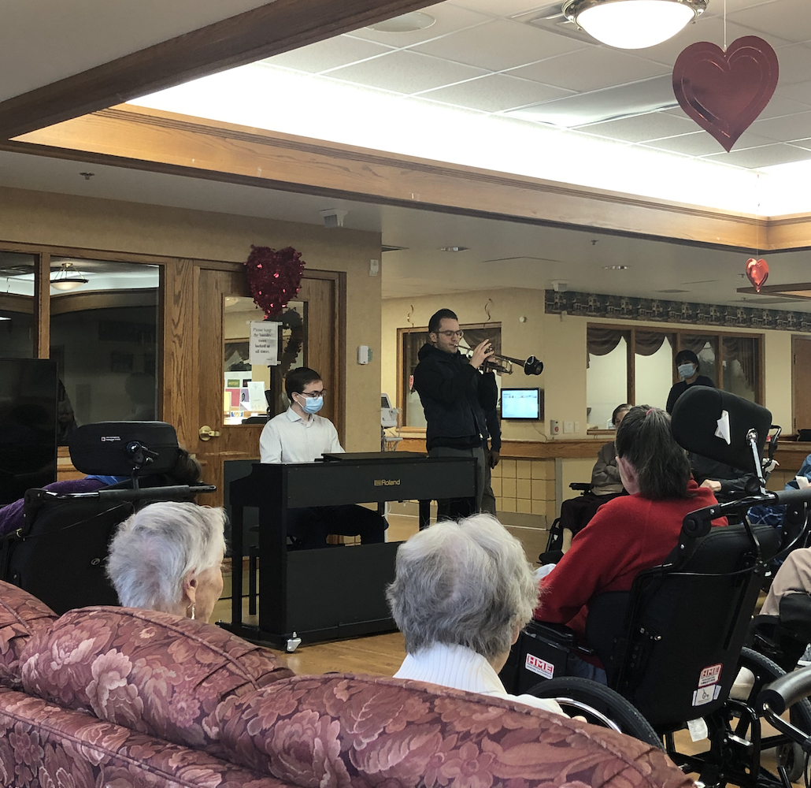
Concerts in Care Ontario
30-40 minutes concerts
Musicians- previous connection/experience in LTC
Interactive: connection, Q & A, instrument exploration
Notes:
Debra

Slide 9
Research Partnership
Sheridan Centre for Elder Research, RIA, Schlegel Villages, CiCO
Evaluating benefits of CiCO programming
Residents, staff, musicians
Notes:
Kate

Slide 10
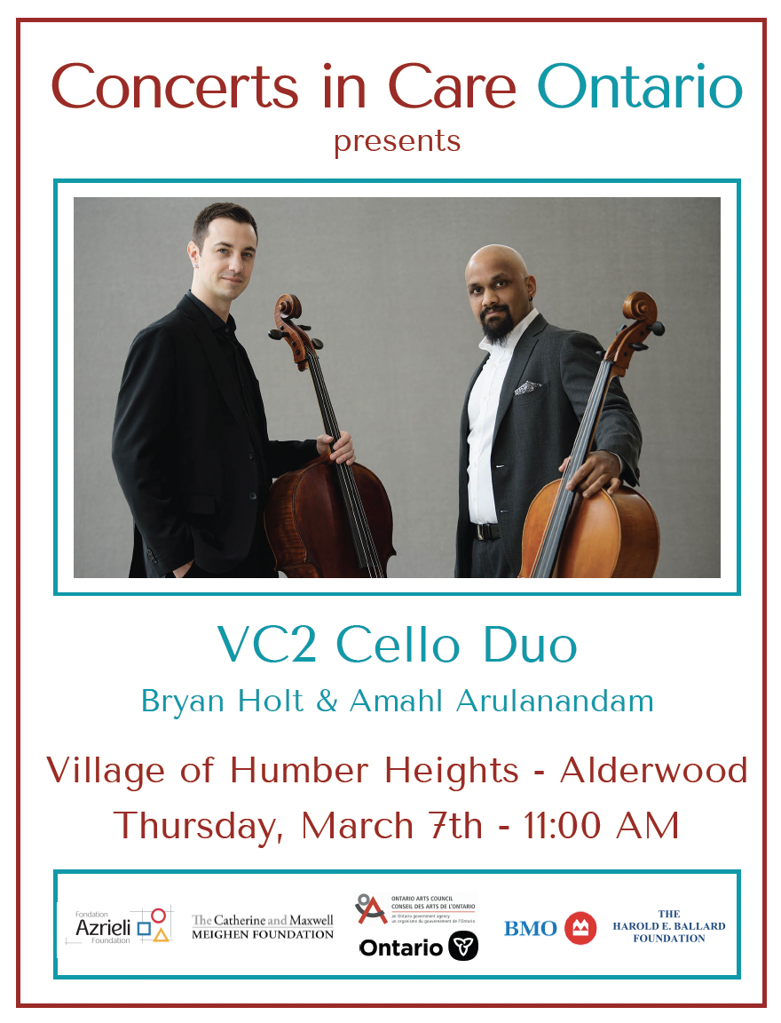
Method
3-, 4-, 8-week concert series
Concerts of 25-30 minutes
Moving throughout Villages
Advertised through calendars, poster
Notes:
Kate

Slide 11
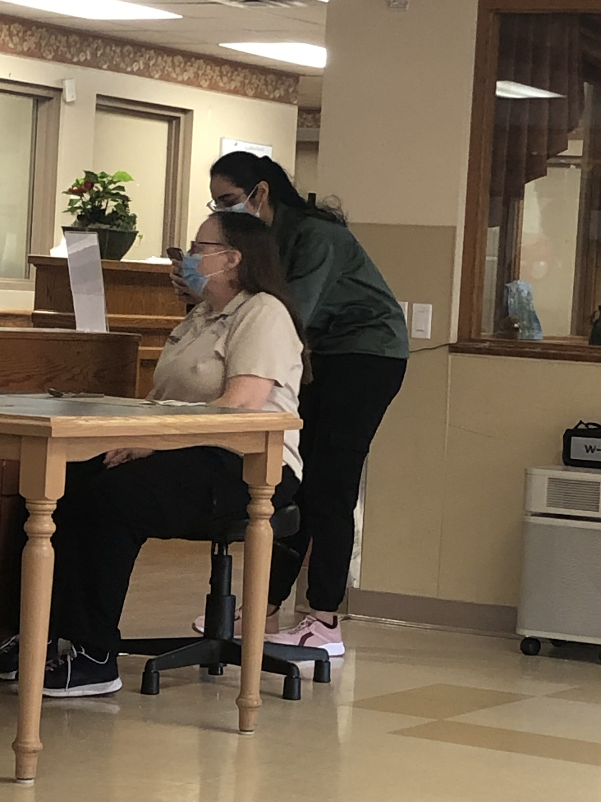
Method
Observations
Surveys for staff and musicians (QR code, email, word of mouth)
Notes:
Kate

Slide 12
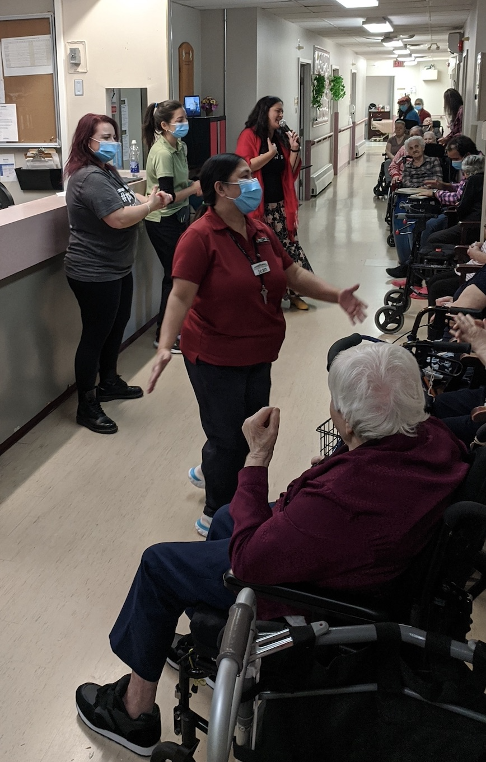
Notes:
Debra

Slide 13
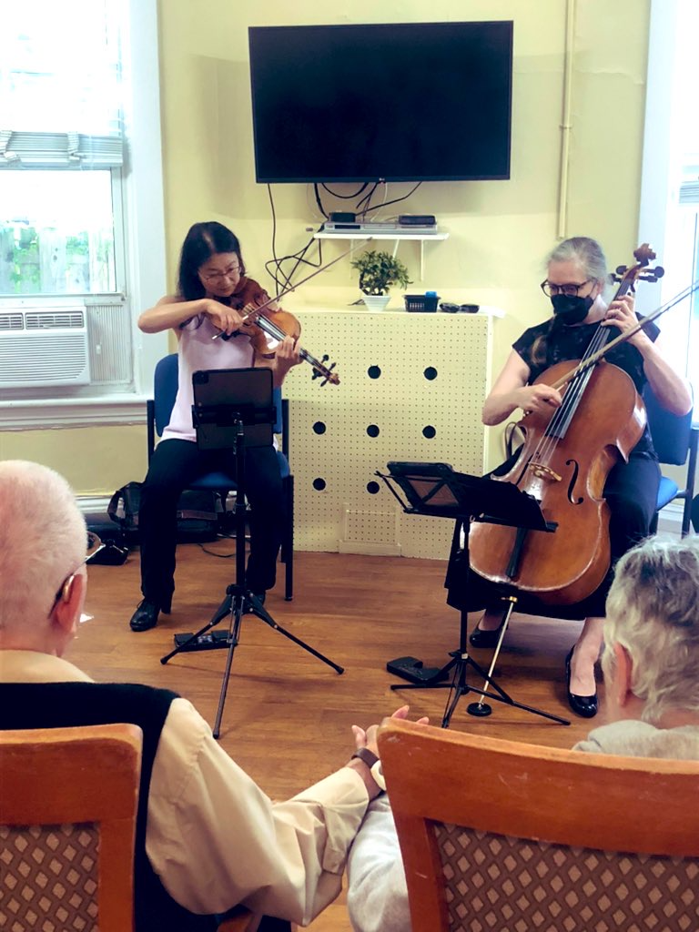
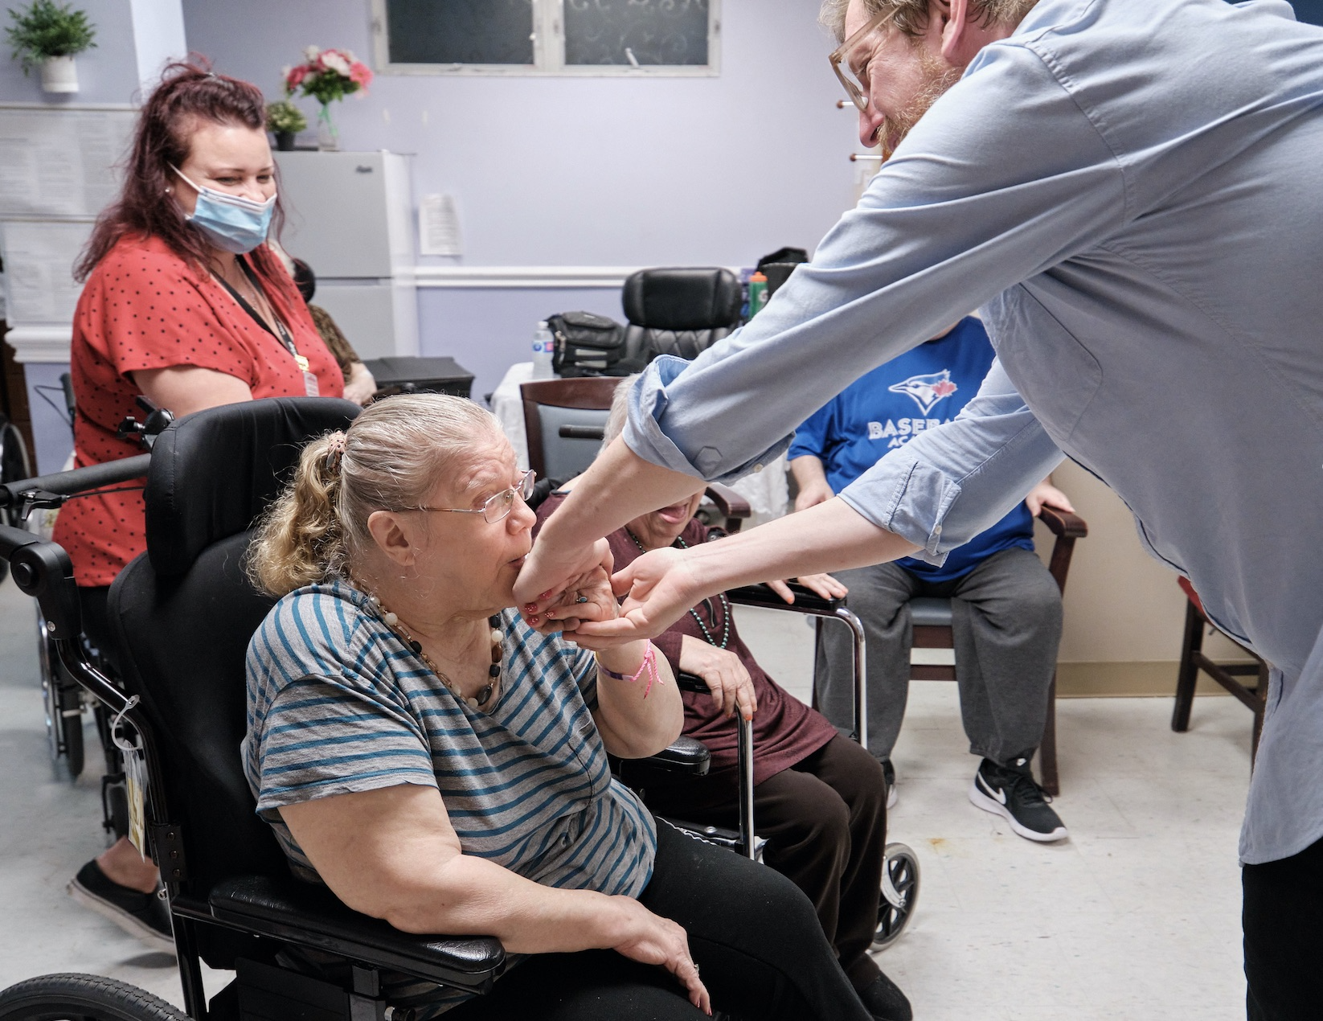
Notes:
Debra

Slide 14
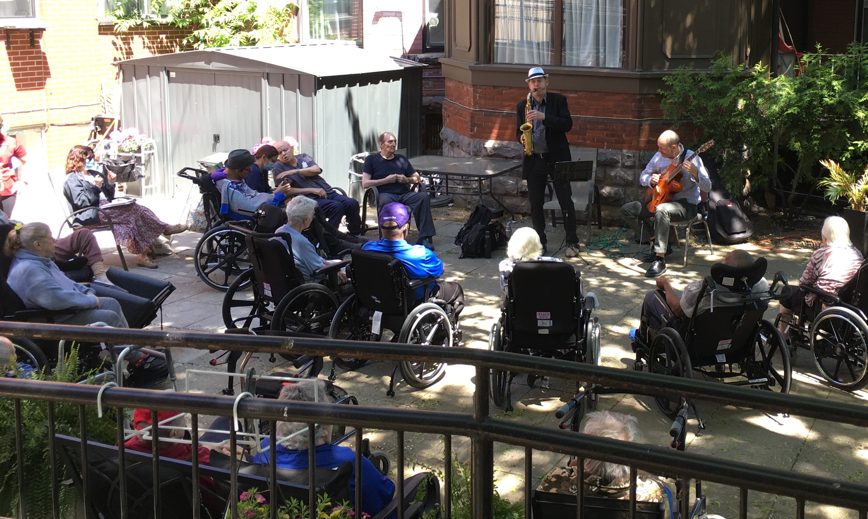
Notes:
Debra

Slide 15
Observations
Wide array of emotional responses to the music
Residents smiling, clapping, singing, moving, conducting
  “I don’t know what you’re saying, but it came out as love”
Interest in genres, instruments, musicians’ training
Engagement with neighbours, visitors, staff, musicians
Respite for care partners
Notes:
Kate

Slide 16
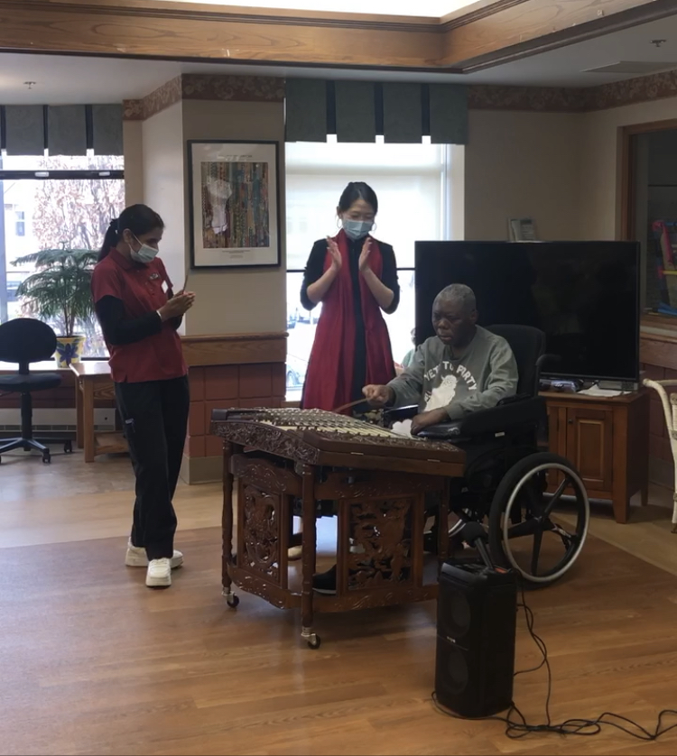
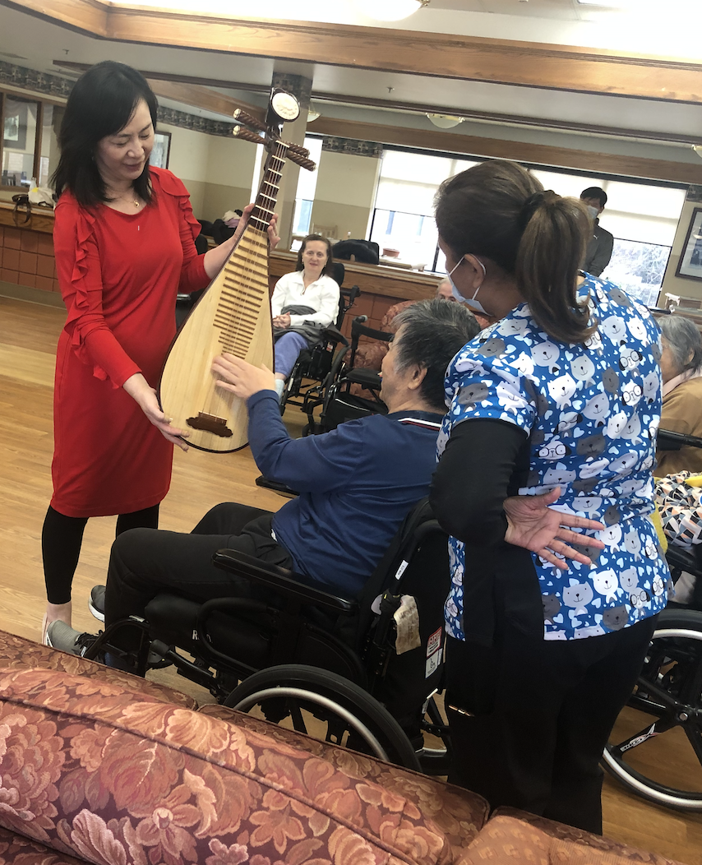
Notes:
Kate

Slide 17
Data from team members
110 respondents (M age = 36 years, 85% female)
Recreation, PSWs, RNs, Leadership etc.
Average enjoyment: 9.1/10
Positive effect on well-being, job satisfaction
“It is a chain reaction.
When the residents are happy it impacts on my day.”
Notes:
Kate

Slide 18
Data from musicians
22 respondents (M age = 44 years, 50% female
Average enjoyment: 9.2/10
100% positive impact on well-being, 95% improved job satisfaction
Notes:
Kate

Slide 19
Data from musicians
“I like to get to the performances early as the residents slowly make their way in … and I love to hangout, ask for requests, catch up, just generally have a good time.” (A1)
“Sometimes performing for them seems to create a spark for them. It feels good to me to have the opportunity to make a difference for them. ” (A4)
“It is a VERY good feeling to bring the joy of music to people, especially those who don't often have the opportunity to be surrounded by live music.” (A8)
Notes:
Kate

Slide 20
Connection
Rewarding
Gratifying
Thoughtful
Essential
Cathartic
Uplifting
Joyful
Satisfying
Moving
Engaging
Notes:
Kate- breaking the stigma

Slide 21
Next steps
Exploring secondary benefits for quality indicators (falls, personal expressions) and staff quality of work (mood, morale, absenteeism, retention)
Potential for deeper and stronger connections with residents and colleagues
Notes:
Kate

Slide 22
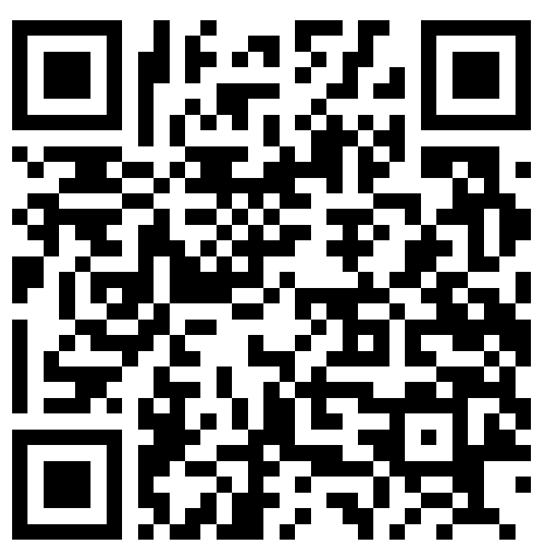
Concerts at your Village?
Staff: More concerts! Mix of genres, more interaction, involve visitors, build set lists with residents, move outdoors, sing-alongs
Musicians: More staff support for residents, share home’s equipment list ahead of time, communication with staff, designated stage area, parking
Notes:
Debra- virtual pre-recorded concert opportunities
Schlegel discount!

Slide 23


Acknowledgments
Schlegel Villages
Concert Coordination
  Brenton Chan
Research Support
  Laura Du
  Erin Delaney
  RIA Staff Team and Schlegel Villages Support Office
Notes:
Debra

Slide 24
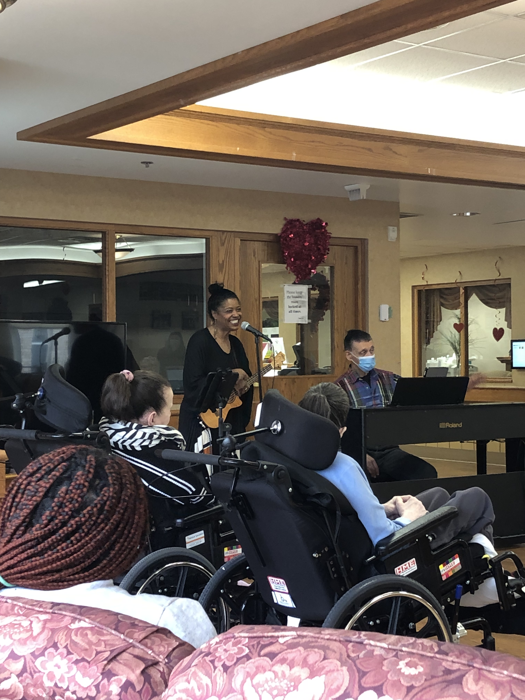
Thank you!!
To contact us:
kate.dupuis@sheridancollege.ca
debra@concertsincareontario.com
Notes:
Debra

